Slide 1

COMPARATIVE ANALYSIS OF MACHINE LEARNING ALGORITHMS FOR 5G COVERAGE PREDICTION
Presented By :
S.Chandra Kumar
1053-23-504-052
Stream:MSc.(Computer Science)

Slide 2


ABSTRACT
Predicts 5G signal strength in different areas using ML models instead of outdated traditional models.
ML provides higher accuracy and adaptability than traditional models.

Slide 3


EXISTING SYSTEMS
Traditional systems use Hata, COST-231, ITU-R models .
They rely on fixed equations, and do not perform well in dynamic 5G environments.
DISADVANTAGES
Inaccurate in urban/indoor areas
No adaptability to new data
Poor mmWave

Slide 4

PROPOSED SYSTEM
1. Smart Learning from Data: The system uses machine learning to learn from real and fake (simulated) data . so it can guess 5G signal coverage more accurately.
2. Uses Multiple ML Models: It uses machine learning models like Linear Regression, to make better predictions and keeps improving as it gets new data.
3. Accuracy + Map View: It checks how correct the results are using MAE, RMSE, and R² scores and shows 5G coverage maps using GIS tools, which helps in planning where to place towers.

Slide 5
ADVANTAGES
Gives more accurate results
Can easily adjust to new locations and situations.
Saves time by reducing the need for manual work.
Works well with high-frequency 5G signals (like mmWave).
APPLICATIONS
Helps to design better Telecom networks.
Useful for planning 5G in both cities and villages.
Supports smart city development.
Useful for connecting self-driving (autonomous) vehicles.

Slide 6

ALGORITHMS :
Linear Regression is used to find the relationship between variables.
It takes input data (independent variable) and output data (dependent variable).
The algorithm fits a straight line through the data points.
This line shows how the output changes with the input.
It helps to make predictions for new or unseen data.

Slide 7
Step-by-step Process of Linear Regression :
Collect Data → Gather historical(Past) observations with inputs (features) and output (target). Example: 5G network logs: Signal strength, number of users, and speed.
Train the Model → The algorithm calculates the best line that minimizes errors (difference between predicted and actual speed).
Test / Predict → Give new input values to the model. It predicts the speed.
Evaluate Accuracy → Compare predicted speeds to actual measured speeds to see how well the model works.

Slide 8

MODULES
1. Data Collection: Collects 5G signal info like strength, location, and terrain from real or fake data.
2. Data Preprocessing: Cleans and fixes the data to make it ready for machine learning.
3. Model Training: Teaches ML models using clean data to understand signal patterns.
4. Prediction & Evaluation: Uses the model to guess signal in new places and checks how correct it is.
5. Visualization & Deployment: Shows results as maps or charts to help plan 5G network areas easily.

Slide 9


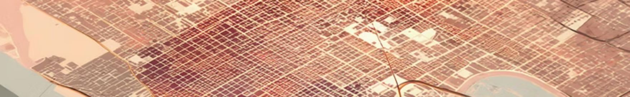
Load → Clean → Train Models → Check Accuracy → Pick Best Mode

Slide 10
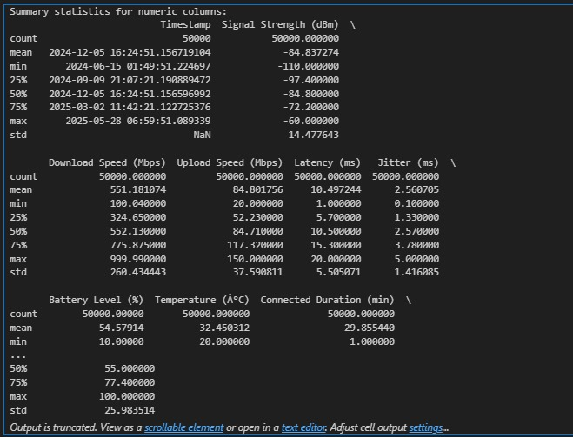
OUTPUT SCREENS:

Slide 11
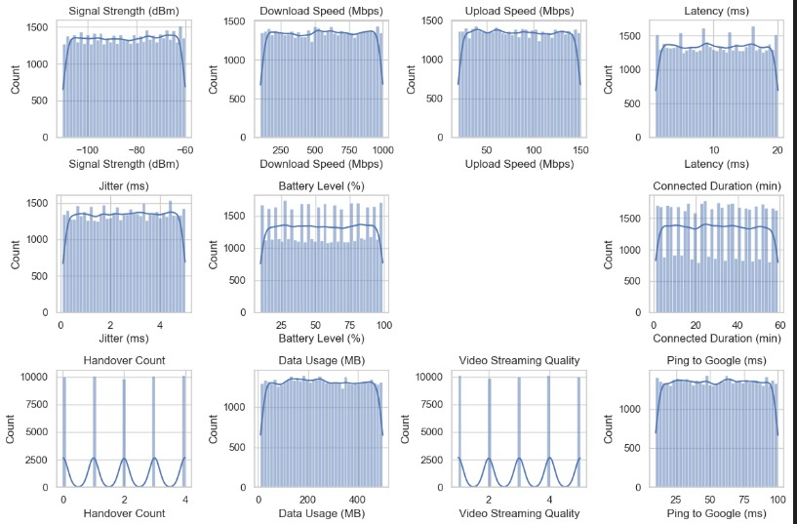

Slide 12
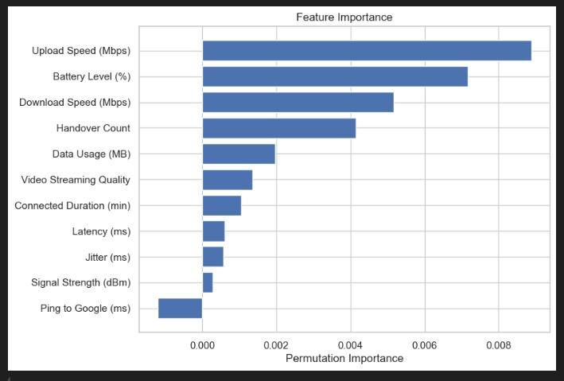

Slide 13
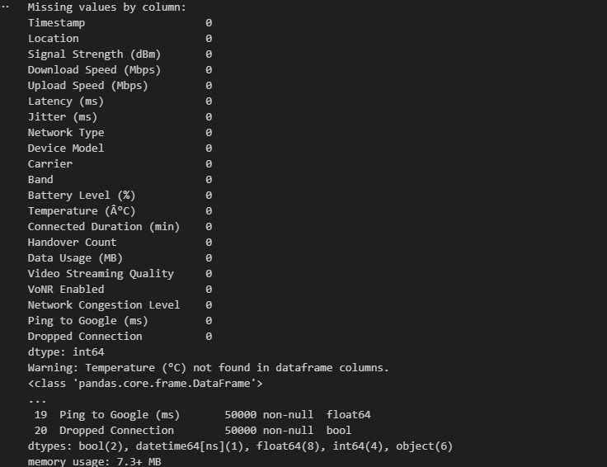

Slide 14
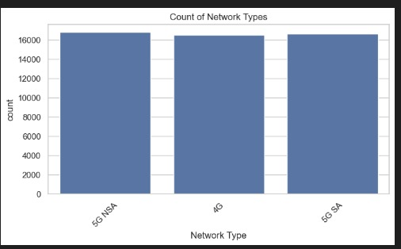

Slide 15
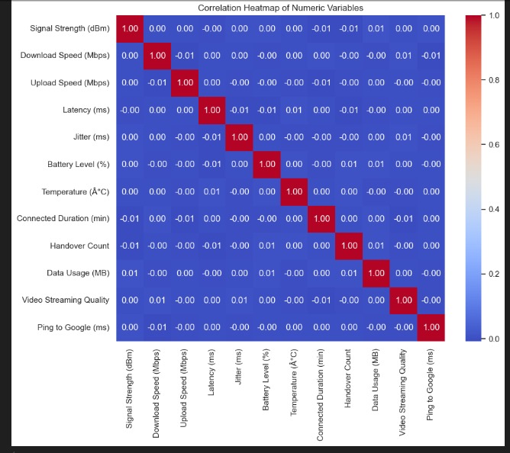

Slide 16
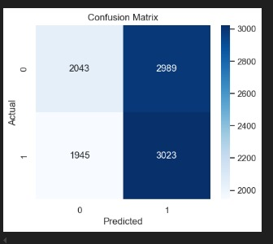

Slide 17
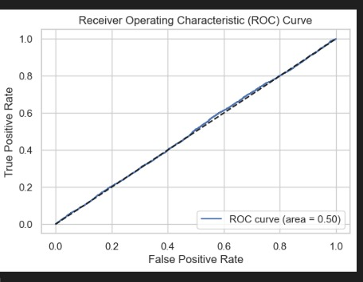

Slide 18
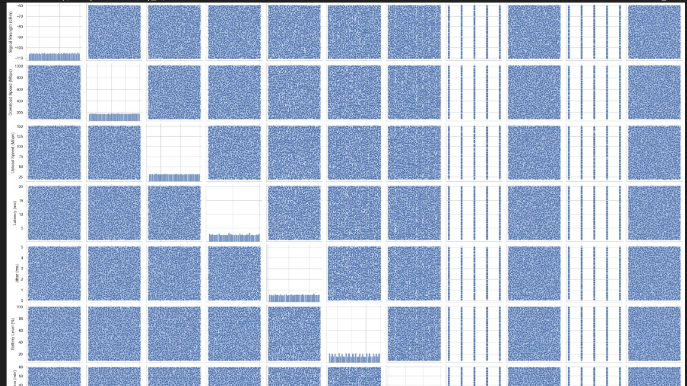

Slide 19

REQUIREMENT SPECIFICATIONS
Hardware Specifications :
Processor : intel i5
RAM : 8GB RAM
Hard Disk : 500GB - 1 TB SSD
Connectivity: 5G/4G LTE/Wi-Fi 6
Software Specifications :
Operating System : Windows XP/8/10
Coding Language : Python
Database : MySQL
Tools: Scikit-learn, Pandas, Matplotlib, Seaborn
Software Used : VS Code

Slide 20

CONCLUSION :
Predict 5G coverage using ML
Compare performance of ML models
Help in real-world tower placement
Build an intelligent, automated system

Slide 21

THANK YOU

